Slide 1
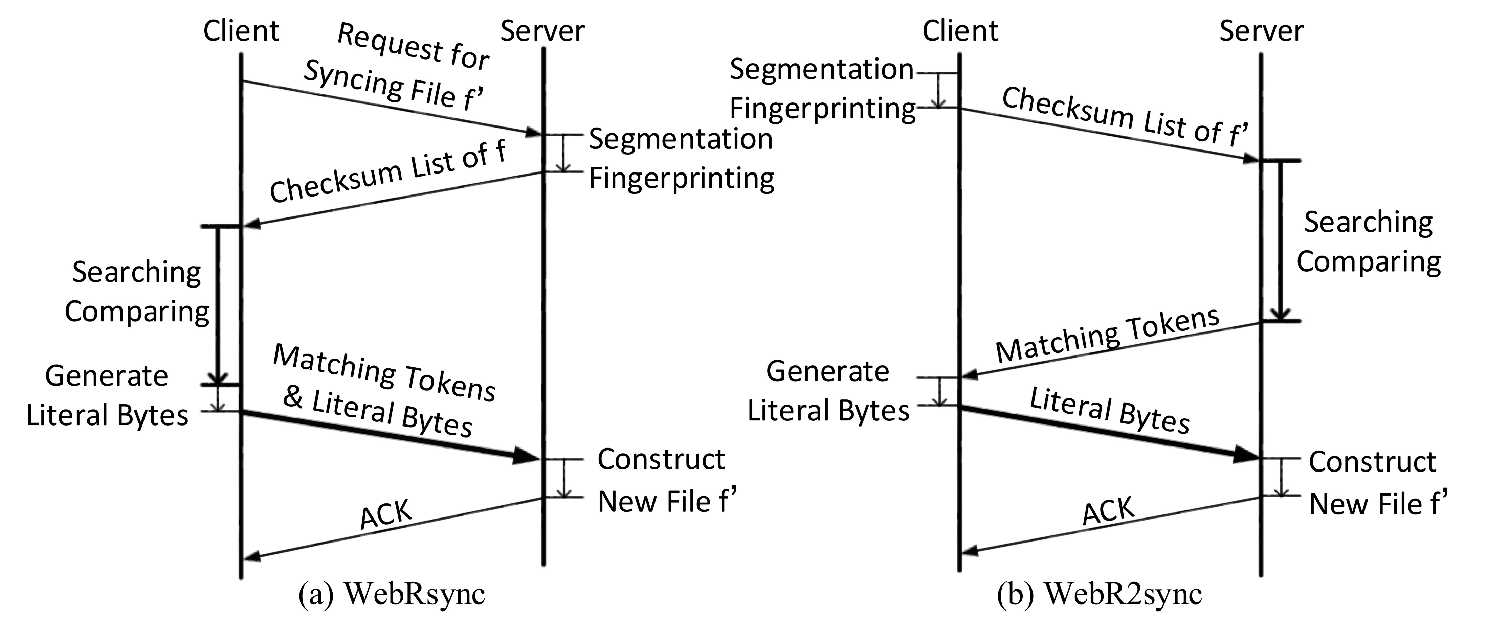
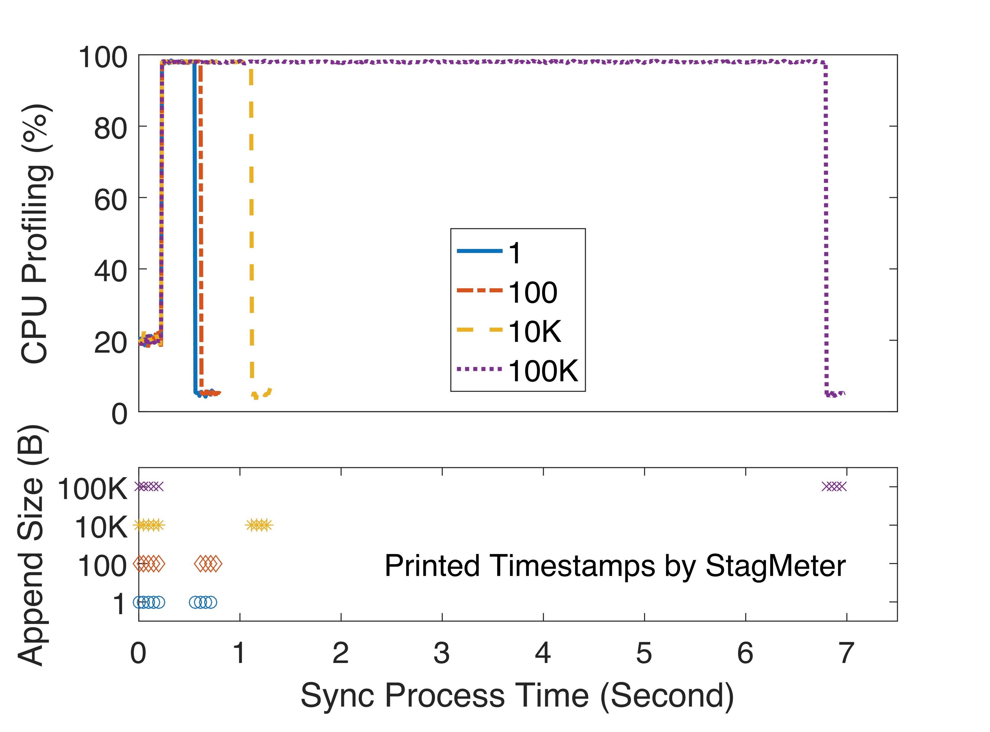
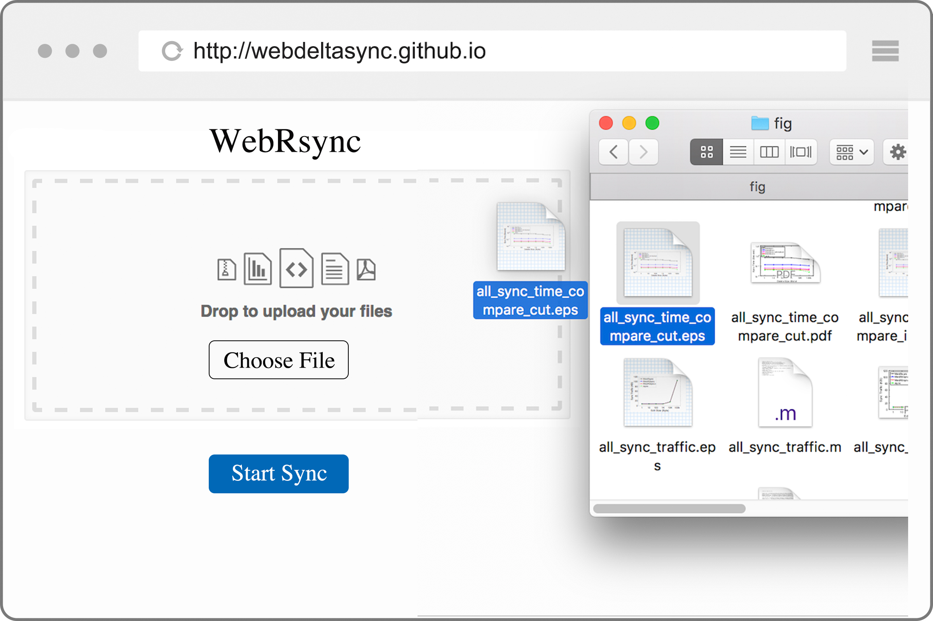
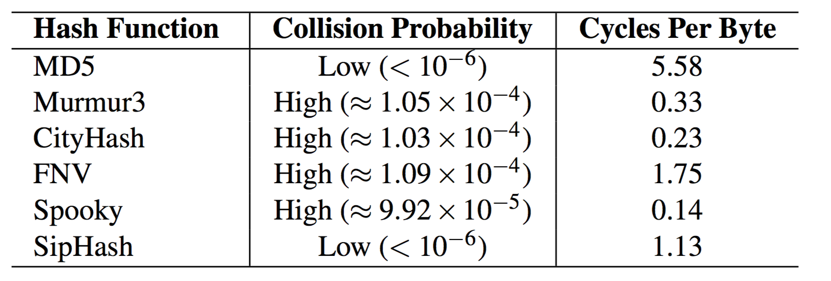
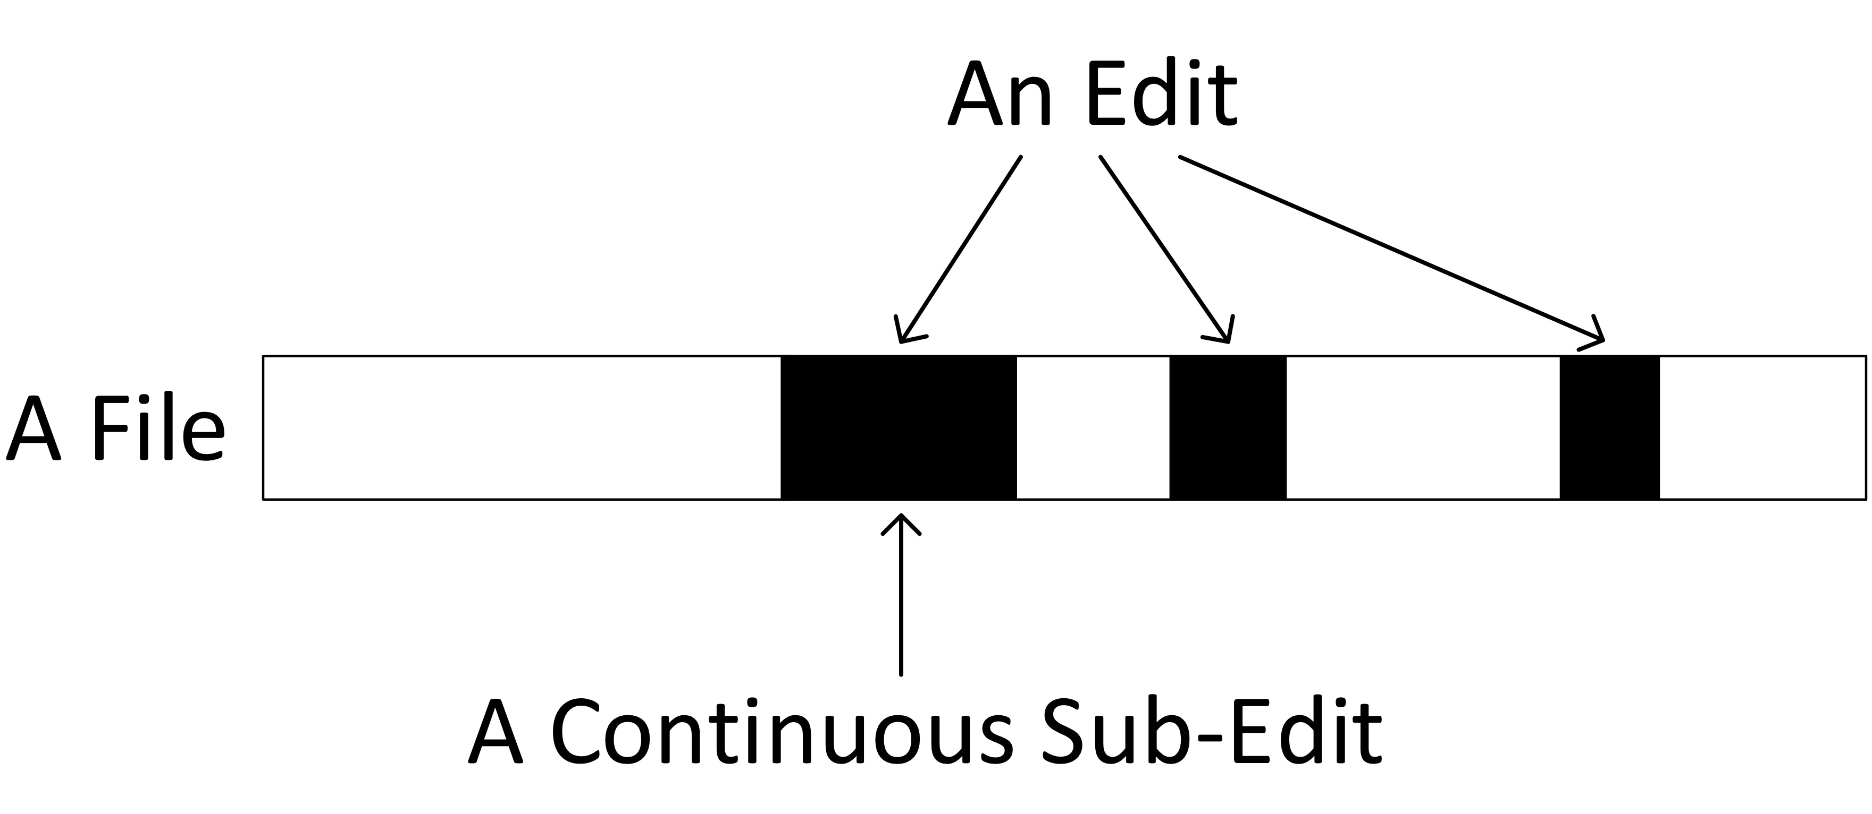
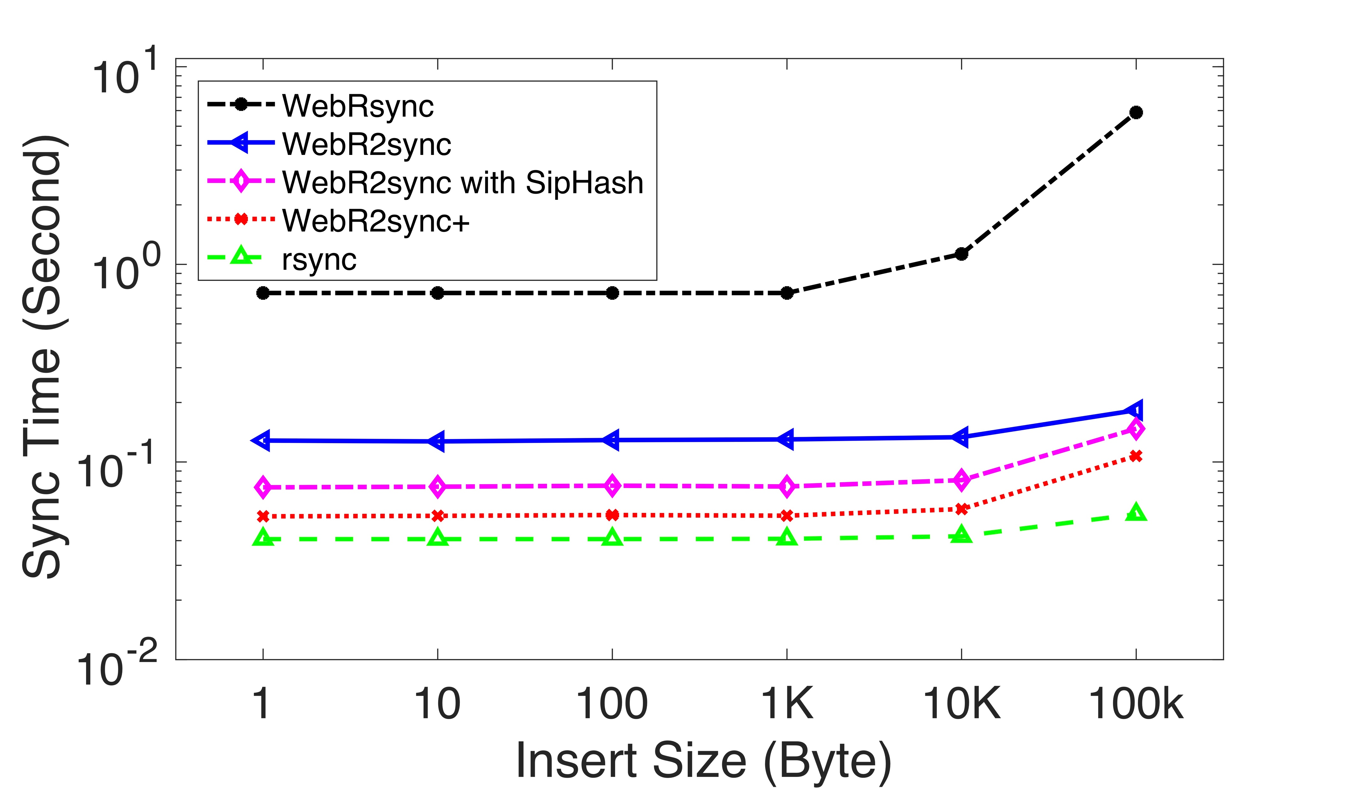
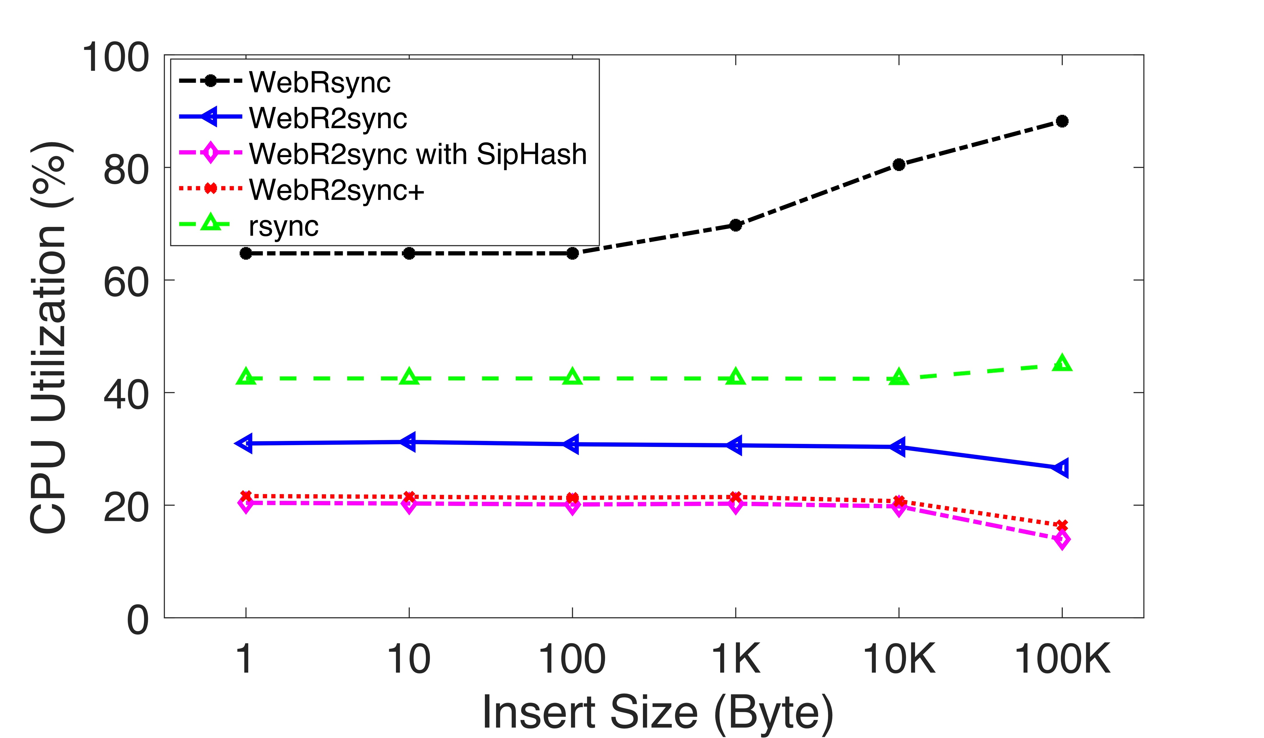
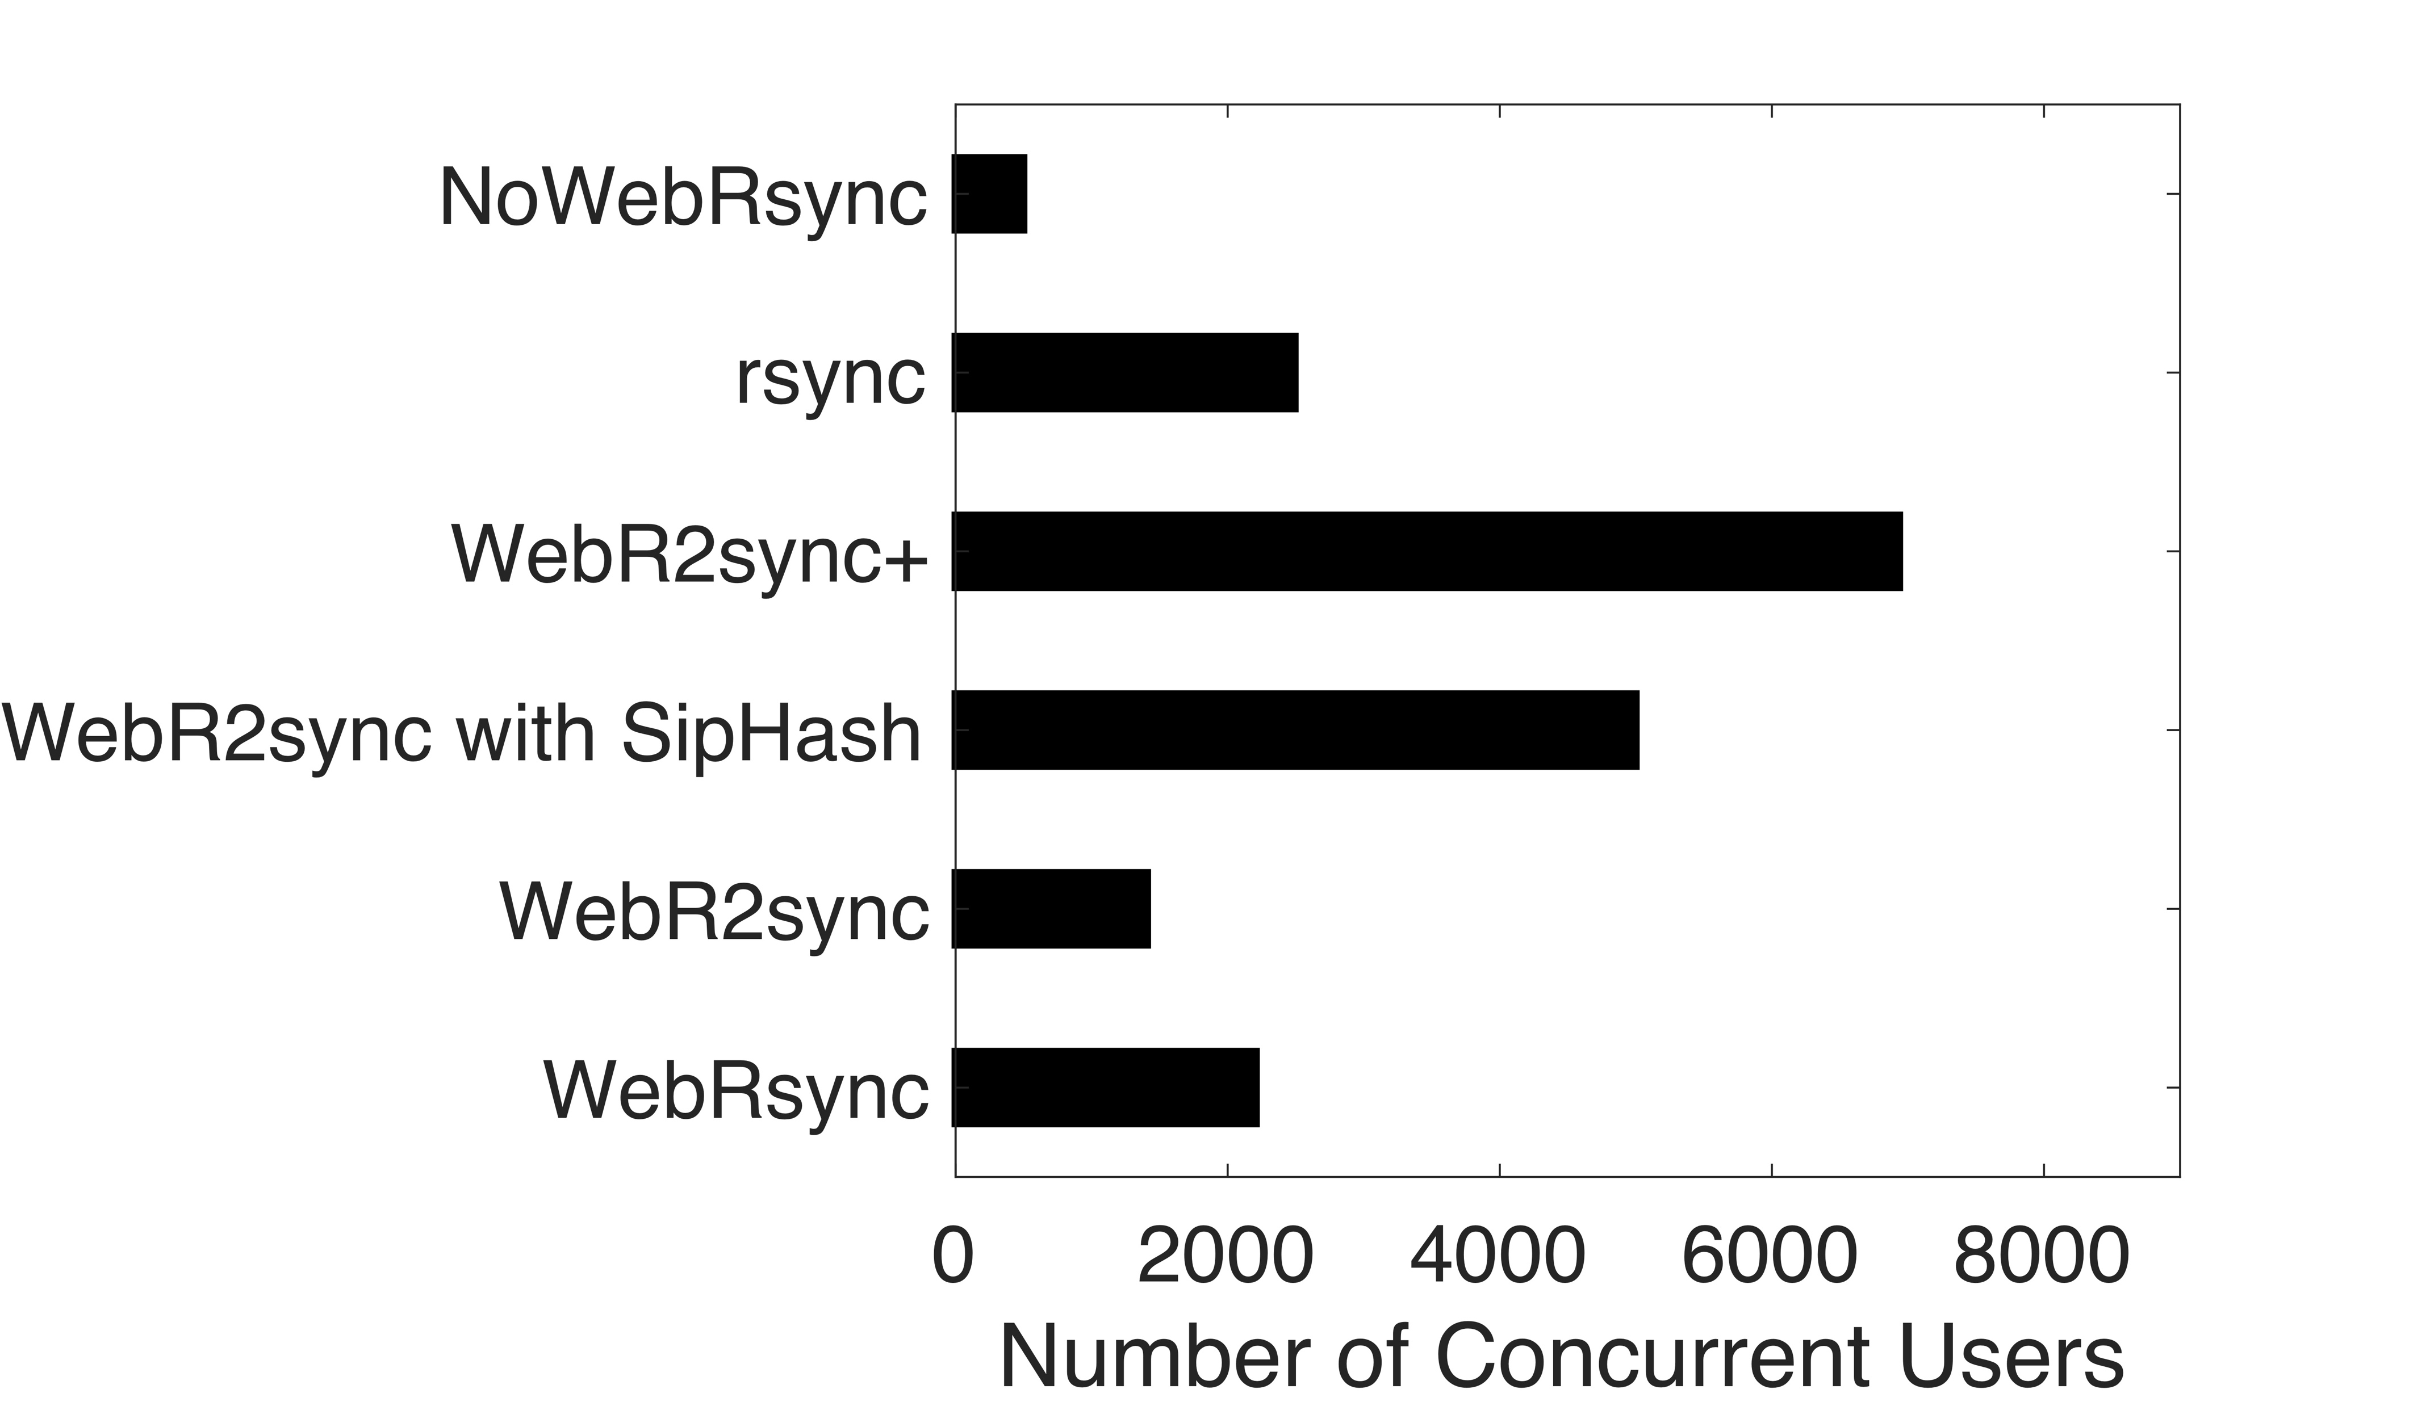
Towards Web-based Delta Synchronization for Cloud Storage Services
He Xiao and Zhenhua Li, Tsinghua University; Ennan Zhai, Yale University; Tianyin Xu, UIUC;
Yang Li and Yunhao Liu, Tsinghua University; Quanlu Zhang, Microsoft Research Asia; Yao Liu, SUNY Binghamton
Motivation
Practical delta sync techniques are only available for PC clients and mobile apps, but not web browsers.
To understand the fundamental obstacles of web-based delta sync, we implement a delta sync solution called WebRsync, using JavaScript, WebSocket, and HTML5 File APIs.
WebRsync severely suffers from the inefficiency of JavaScript execution inside web browsers, thus leading to frequent stagnation and even hanging as shown in Figure 1.
WebR2sync: Client-side Optimizations
WebR2sync reverses the process of WebRsync.
Moving the computation-intensive search and
comparison operations to the server side.
Shifting the lightweight segmentation and
fingerprinting operations to the client side.
Figure 2: Design flow of WebRsync vs. WebR2sync.
WebR2sync+: Sever-side Optimizations
While WebR2sync significantly cuts the computation burden on the web client, it brings considerable computation overhead to the server side. We make two-fold additional efforts to optimize the server-side computation overhead.
Exploiting the locality of file edits in chunk search. As shown in Figure 3, the locality of real-world file edits offers us an opportunity to bypass a considerable portion of (unnecessary) chunk search operations.
Replacing MD5 with SipHash in chunk comparison. SipHash seeks out a sweet spot between collision probability and overhead as shown in Table 1.
Figure 1: Stagnation captured by StagMeter for Append operation and the associated CPU utilizations.
System UI
(a) An edit consists of several continuous sub-edits.
(b) The worst case of a file edit in terms of locality.
Table 1: A comparison of candidate pseudorandom hash functions.
Figure 3: Examples of continuous
sub-edits due to the locality of file edits.
Results
Figure 4: Average sync time.
Figure 5: Average client-side CPU.
Figure 6: Number of concurrent clients.

